Slide 1
CSE 474 Software Design and Architecture
Lecturer Rabia Khan

Slide 2
Topics Covered
Basic Model View Controller (MVC) Architecture
Controller Pattern
Example of Controller Pattern
Bloated Controller
Creator Pattern
Example of Creator Pattern

Slide 3
Issues in Software Architecture
Benefits of Development of Software Using layers
User Interface should never contain application logic.
Model-View-Controller Concept
  Separation of:
    Application Logic (Controller)
    Data/Business Logic (Model)
    User-interface/Presentation Logic (View)

Slide 4
Model-View-Controller Architecture Around Us!! …..
Imagine a bank
The safe is the Database – this is where all the most important goodies are stored, and are nicely protected from the outside world.
Then we have the bankers or in programmatic terms the Models. The bankers are the only ones who have access to the safe (the DB).
Average bank workers are the Controllers. They take the information from the bankers (the Models) and bring it to the bank customers the Views.
The bankers (Models) make all the important decisions (business logic is kept in the model as much as possible )
The controllers, average workers, only ask the banker for details, get the info, and pass it on to the customer (the View)
Models should not talk to Views directly. This communication between the Model and the View is always handled by the Controller.

Slide 5
Why do we use Layered Approach?
Benefits of Model-View-Controller Architecture:
Model : The model is the part of the component that encapsulates the application's data. It will often provide routines to manage and manipulate this data in a meaningful way in addition to routines that retrieve the data from the model.
  In general, the underlying data access technique should be encapsulated in the model. In this way, if an application is to be moved from a system that utilizes a flat file to store its information to a system that uses a database, the model is the only element that needs to be changed, not the view or the controller.

Slide 6
Benefits of Model-View-Controller Architecture:
View: The view is the part of the component that is used to render the data from the model in a manner that is suitable for interaction.
  For a web-based application, the view would generally be an HTML page that is returned. The view pulls data from the model (which is passed to it from the controller) and feeds the data into a template which is populated and presented to the user. The view does not cause the data to be modified in any way, it only displays data retrieved from the model.

Slide 7
Benefits of Model-View-Controller Architecture:
Controller : The controller is responsible for responding to user actions.
  In the case of a web application, a user action is (generally) a page request. The controller will determine what request is being made by the user and respond appropriately by triggering the model to manipulate the data appropriately. The controller does not display the data in the model, it only triggers methods in the model which modify the data, and then pass the model into the view which displays the data.

Slide 8
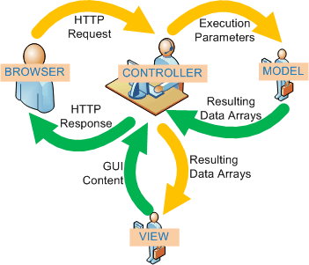
MVC (Model-View-Controller)
1
2
3
6
5
4

Slide 9
Controller
An input system event (system operation) is an event generated by an external actor.
Examples,
  when a cashier using a POS terminal presses the "End Sale" button to indicate “the sale has ended”.
  writer using a word processor presses the "spell check“ button, he is generating a system event indicating "perform a spell check.“
A Controller object is a non-user interface object responsible for receiving or handling a system event.
Note that windows, applets, etc. typically receive events and delegate them to a controller.

Slide 10
Controller
Solution:
  There are two alternate solutions. Assign the responsibility for receiving or handling a system event message to a controller class that
    Represents the overall system, device, or subsystem. This class is called facade controller.
    Represents a use case scenario within which the system event occurs. Often this class is named <UseCaseName>Handler, <UseCaseName>Coordinator, or <Use-CaseName>Session. Use the same controller class for all system events originating in the same use case.

Slide 11
Controller Pattern
Name: | Controller
Problem: | What first object beyond the UI layer receives and coordinates ("controls") a system operation?
Solution: (advice) | Assign the responsibility to an object representing one of these choices: Represents the overall "system," a "root object," a device that the software is running within, or a major subsystem (these are all variations of a facade controller). Represents a use case scenario within which the system operation occurs (a use case or session controller)

Slide 12
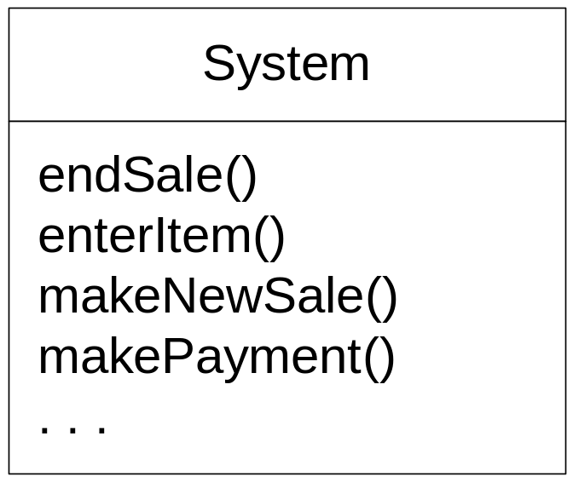
What are the events being received from outside in POS Application?

Slide 13
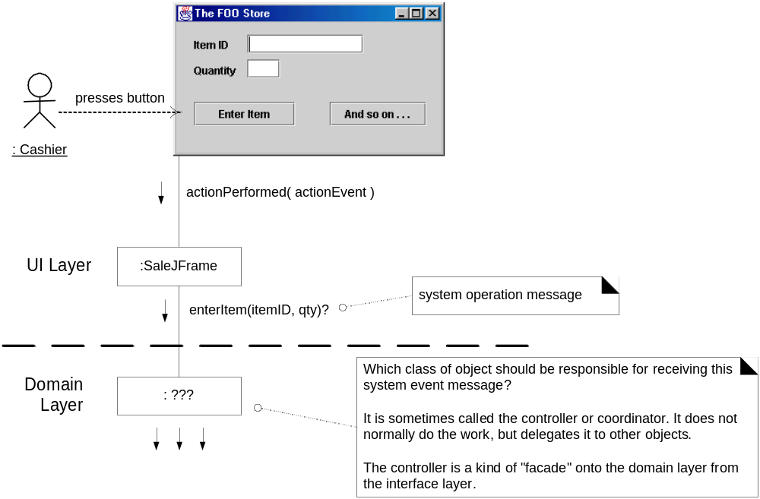
What object should be the Controller for enterItem?

Slide 14
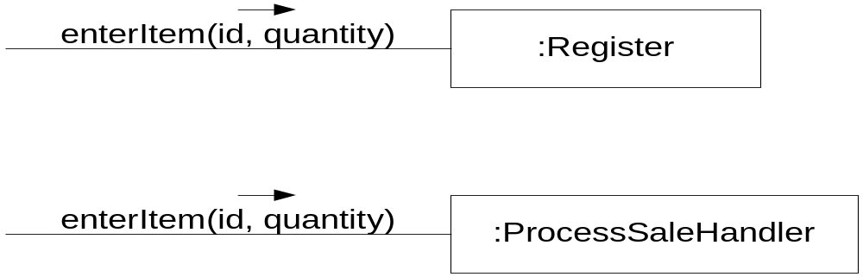
Choice of allocating system operations in two controller types
By the controller pattern, there are choices
  A controller class to represent the whole system, some root object … Register for example.
  A controller to handle all system events of a use case, ProcessSaleHandler for example
Which choice is more appropriate depend on many other factors. The value of the pattern is to make you consider the alternatives.

Slide 15
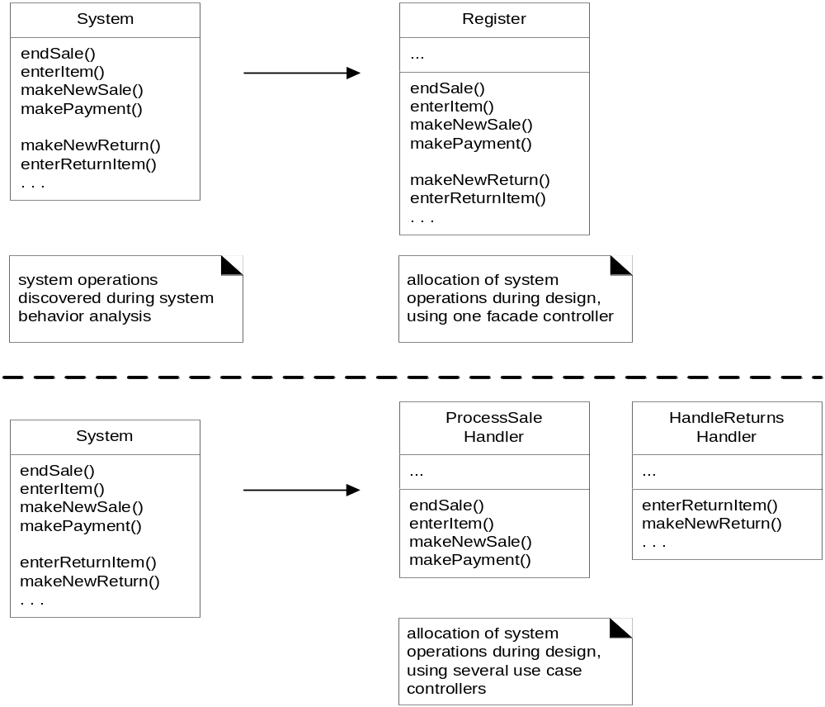
Allocation of system operations in two controller types

Slide 16
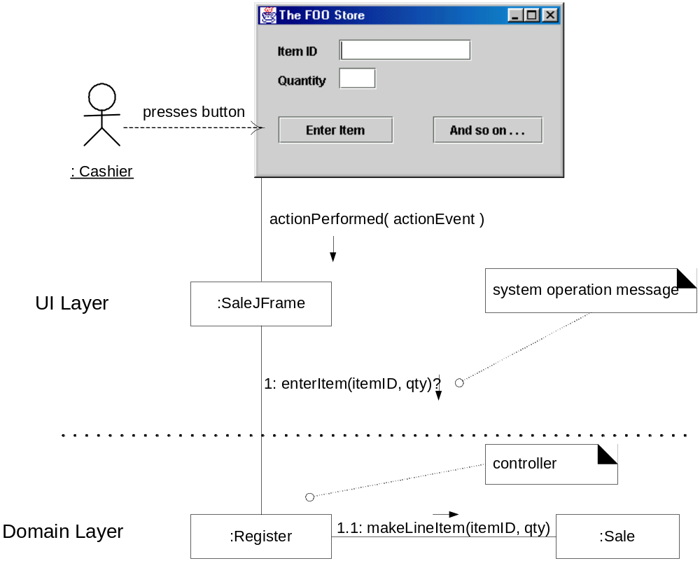
Desirable coupling of UI layer to domain layer

Slide 17
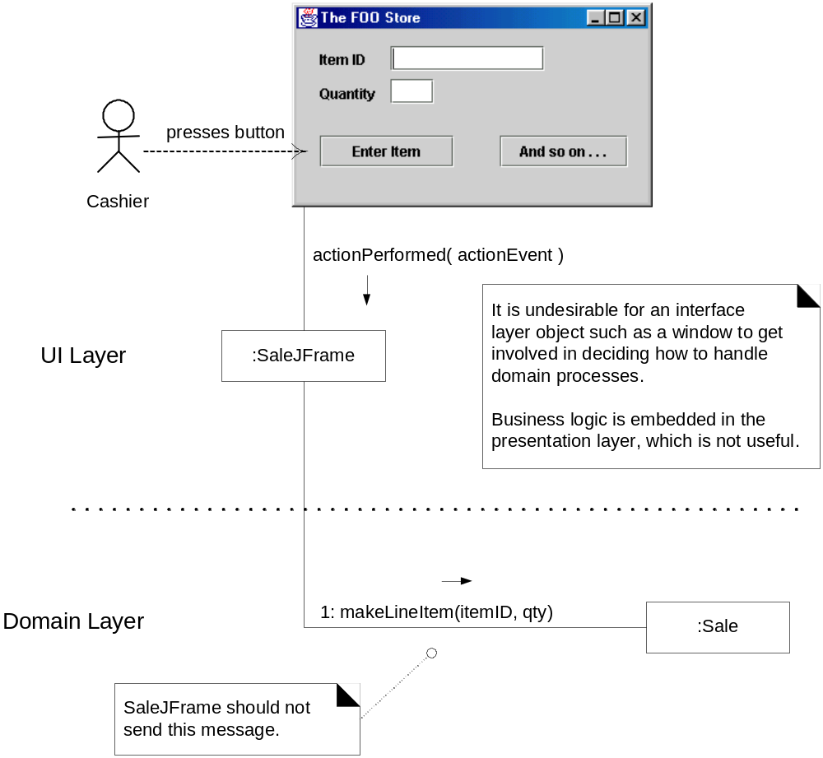
Less desirable coupling of interface layer to domain layer

Slide 18
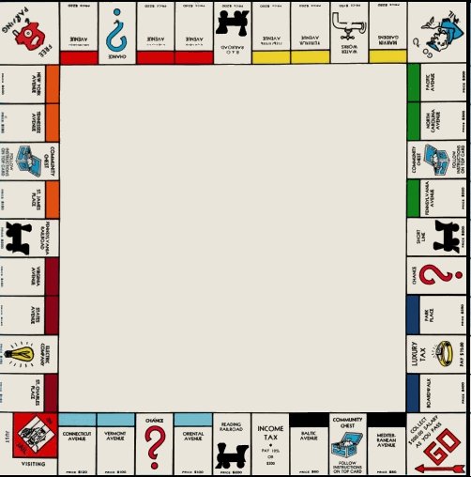
Monopoly Game Example
MonopolyGame is played with 2 Die and on a Board.
2-8 Players plays 1 MonopolyGame.
A Player owns a Piece.
0-8 Piece is on 1 Square.
0-1 Player owns o-n PropertySquare.
1 Board contains 40 Squares. Square-objects cannot exist without a Board-object.

Slide 19
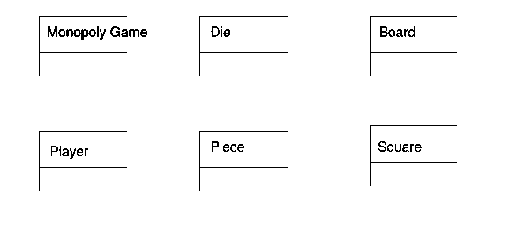
Monopoly Game Domain Model
Identify conceptual classes first

Slide 20
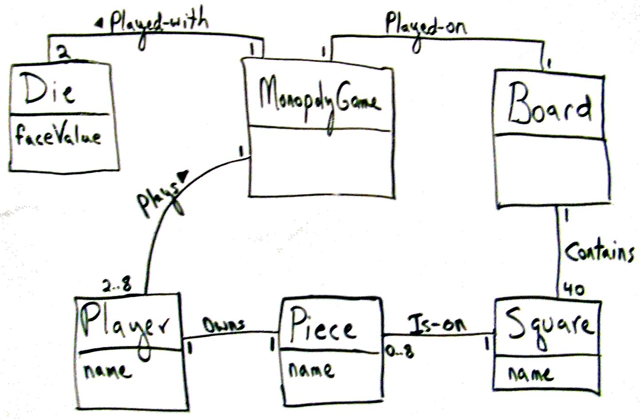
Monopoly Game Domain Model
Identify attributes and associations

Slide 21
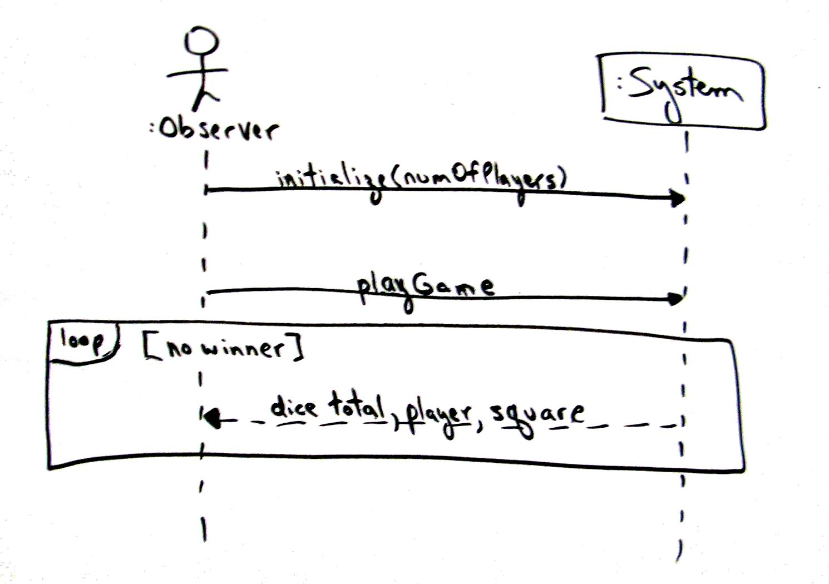
Monopoly Game Example
Next, identify the methods (the caller and the callee)

Slide 22

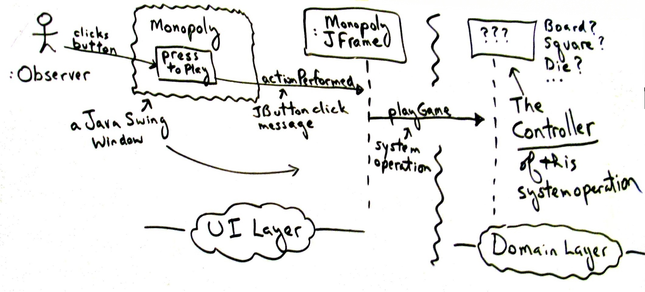
Monopoly Example
What Class beyond the User Interface Layer is going to receive all the events??

Slide 23
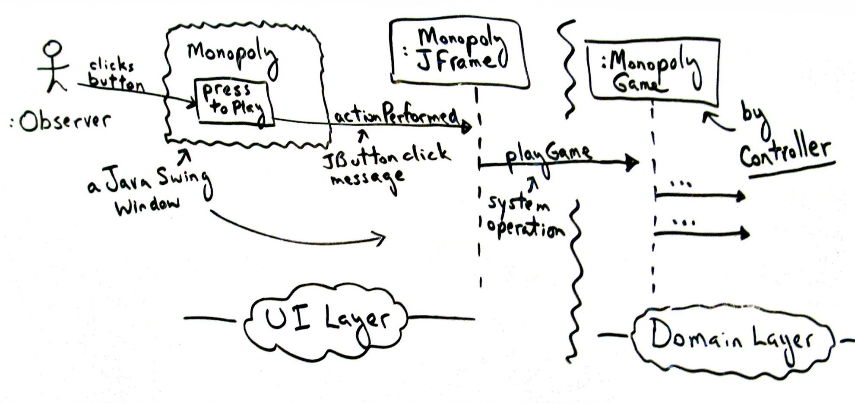
Monopoly Example

Slide 24
Keynote
Controller Pattern is delegation pattern. UI layer objects must ‘delegate’ work requests to another layer. For external system events, you need a Handler. Controller Pattern helps you make a suitable choice

Slide 25
Benefits
Increased potential for reuse and pluggable interfaces:
  Ensures that application logic is not handled in interface layer. On the contrary an interface-as-controller design reduces the opportunity to reuse logic in future applications, since logic that is bound to a particular interface is seldom applicable to other applications.
Opportunity to reason about the state of the use case:
  Sometimes system operations are required to occur in a legal sequence. For example, makePayment cannot occur until endSale operation as occurred. A controller allows to save this state information somwhere(when the same controller class throughout the use case is used, as recommended).

Slide 26
Bloated Controllers
Poorly designed, a controller class will have low cohesion, be unfocussed and handling too many areas of responsibilities; this is called a bloated controller.
Signs of bloating are:
  Single controller class receiving all system events (sometimes this happens in a façade controller)
  Controller itself performs many tasks necessary o fulfill system’s event without delegating the work.
  Controller maintains too many information which was ideally supposed to be distributed to other objects, or it duplicates information found elsewhere.

Slide 27
Case Study
Go through the Java Calculator (MVC Approach) to have an insight into programming of Controller, Model and View Class

Slide 28
Creator Pattern

Slide 29
Creator Pattern
The creation of objects is one of the most common activities in an object-oriented system.
Consequently, it is useful to have a general principle for the assignment of creation responsibilities.
Assigned well, the design can support low coupling, increased clarity, encapsulation, and reusability.

Slide 30
Creator Pattern
Who should be responsible for creating a new instance of some class?

Slide 31
Creator Pattern - Solution
Assign class B the responsibility to create an instance of class A if one of these is true (the more the better):
  B "contains" or compositely aggregates A
  B records A
  B closely uses A
  B has the initializing data for A that will be passed to A when it is created.
    Thus B is an Information Expert with respect to creating A
If more than one option applies, usually prefer a class B which aggregates or contains class A.

Slide 32
Creator Pattern – Monopoly Example

Slide 33
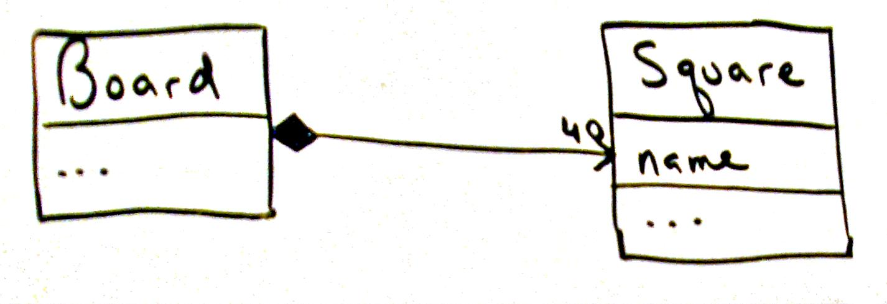
Creator Pattern – Monopoly Example

Slide 34
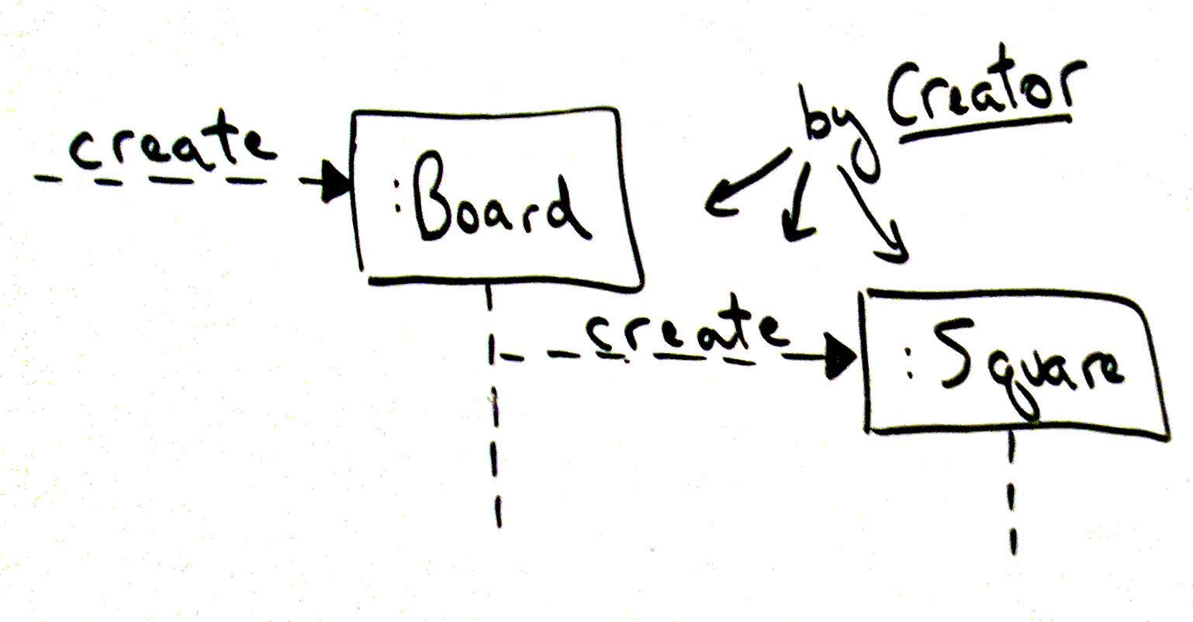
Creator Pattern – Monopoly Example

Slide 35
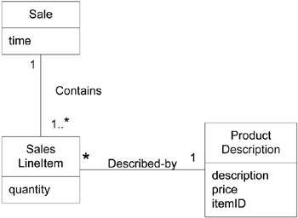
Creator Pattern - Example
A Sale contains (in fact, aggregates) many SalesLineItem objects
Creator pattern suggests that Sale is a good candidate to have the responsibility of creating SalesLineItem instances
Partial Domain Model- POS Terminal Example

Slide 36
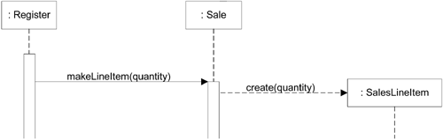
Creator Pattern - Example
This assignment of responsibilities requires that a makeLineItem() method be defined in Sale.

Slide 37
Creator Pattern
Creator guides the assigning of responsibilities related to the creation of objects
The basic intent of the Creator pattern is to find a creator that needs to be connected to the created object in any event
  Composite aggregates Part
  Container contains Content
  Recorder records Recorded
All are very common relationships between classes in a class diagram.
Creator suggests that the enclosing container or recorder class is a good candidate for the responsibility of creating the thing contained or recorded.
This is only a guideline.

